Slide 1
Process Algebra

Slide 2
What is process algebra ?
Algebra: the study of mathematical symbols and the rules for manipulating these symbols
Process: a sequence of computations/operations
Process algebra: an algebraic approach to the study of concurrent processes
Milner’s observation: concurrent processes have an algebraic
structure. Having 2 processes, P and Q, we can form a new process by combining P and Q sequentially or in parallel. The behavior of this new process would depends on that of P and Q and on the operation used to compose them.
Formal description languages are algebraic: they consist of a collection of operations for building new process descriptions from existing ones.

Slide 3
What is it good for ?
Is good for formal modelling a system of concurrent processes by focusing on the messages exchanged between processes
We can verify the correctness of a model of a system with respect to given specifications either manually or by using automatic verification tools like the Concurrency Workbench and UPPAAL (e.g. check conditions like deadlock, livelock, starvation, reaching a final state)

Slide 4
Process algebra formalism examples
Process algebra was coined by Bergstra & Klop in 1982.
Hoare’s CSP (Communicating Sequential Processes)
Milner’s CCS (Calculus of Communicating Systems)
Bergstra & Klop’s ACP (Algebra of Communicating Processes)
π-calculus

Slide 5
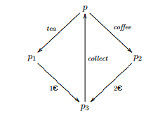
Graph-based Transition systems
Automata
Labeled Transition Systems

Slide 6
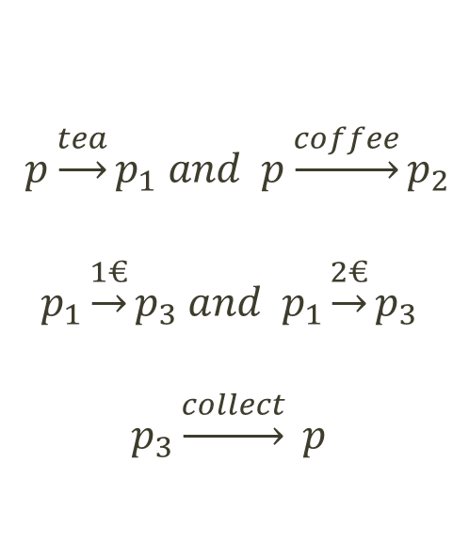
LTS – Labelled Transition Systems
A simple example - a coffee vending machine: user inputs coins, selects tea or coffee and then collects the beverage
$$p\underset{→}{tea}p_{1} and p\underset{→}{coffee}p_{2}$$
$$p_{1}\underset{→}{1€}p_{3} and{ p}_{1}\underset{→}{2€}p_{3}$$
$$p_{3}\underset{→}{collect} p$$

Slide 7
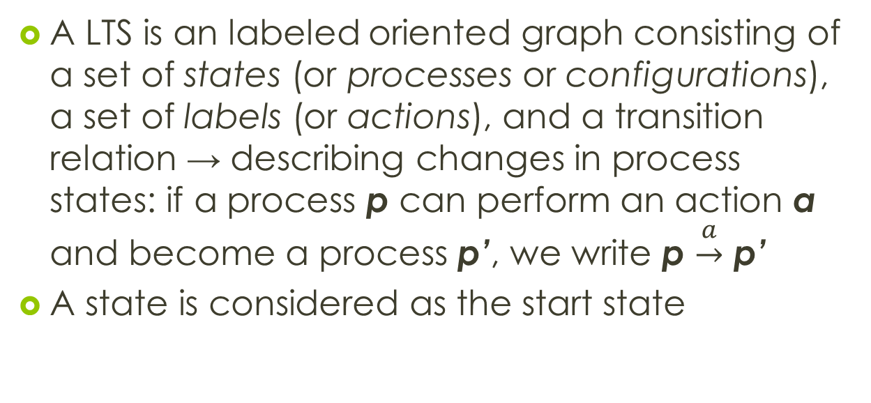
LTS – Labelled Transition Systems - informal
A LTS is an labeled oriented graph consisting of a set of states (or processes or configurations), a set of labels (or actions), and a transition relation → describing changes in process states: if a process p can perform an action a and become a process p’, we write p $\underset{→}{a}$ p’
A state is considered as the start state

Slide 8
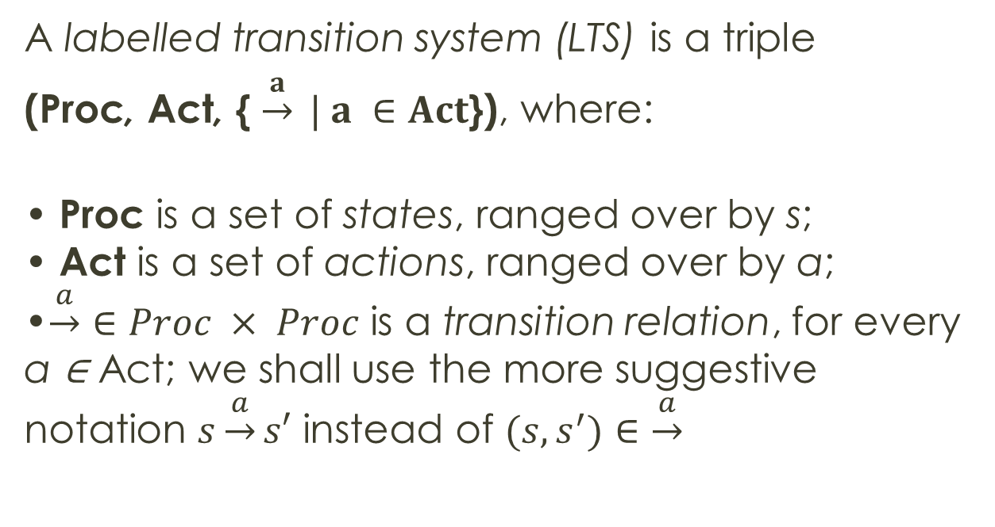
LTS – Labelled Transition Systems - formal
A labelled transition system (LTS) is a triple
(Proc, Act, { $\underset{→}{a} | a ∈Act$}), where:
• Proc is a set of states, ranged over by s; • Act is a set of actions, ranged over by a; •$\underset{→}{a}∈Proc × Proc$ is a transition relation, for every a ∈ Act; we shall use the more suggestive notation $s\underset{→}{a}s′$ instead of $(s, s^{′})∈\underset{→}{a}$

Slide 9
LTS and CCS
CCS expressions formally describe the behavior of concurrent processes
LTS describe the operational semantics of a CCS expression (what is the meaning of each part of a CCS expression and their interractions)
We express CCS expressions into LTSs through SOS (Structural Operational Semantics):
A CCS process will be a LTS state (vertex)
A CCS transition will become a LTS action if it can be derived using a collection of syntax-driven rules (the SOS rules)

